Slide 1
ANOMALYZE: Leveraging AI for Live Network Threat Detection & Visualization
Angel Bajracharya Giovanny Joseph
Background
Intro
Methods
Results
Dashboard
Conclusion
BACKGROUND
Network Security: Digital technologies have evolved rapidly, making network security essential for protecting data flow.
Limitations of Traditional Intrusion Detection Systems (IDS):
IDS can only recognize known signatures and attack patterns
The system needs frequent rule updates to stay effective
Rule-based IDS cannot analyze evolving attack patterns
A self-learning anomaly detection model can detect new cyber threats by analyzing trends in network traffic. By examining packet flow, it provides insights into network security.

Slide 2

ANOMALYZE: Leveraging AI for Live Network Threat Detection & Visualization
Angel Bajracharya Giovanny Joseph
Background
Intro
Methods
Results
Dashboard
Conclusion
RESEARCH OBJECTIVE
The primary goal of this research is to develop an anomaly detection dashboard that leverages machine learning to identify and evaluate network anomalies.
CORE SYSTEM COMPONENTS
Real-Time Packet Sniffer
Captures live network traffic for immediate analysis by the anomaly detection model.
Isolation Forest-Based Detection Model
Utilizes the Isolation Forest (iForest) algorithm to identify anomalous patterns in network behavior.
Interactive Visualization Dashboard
Provides real-time visualizations of network activity along with dynamic risk scoring for detected anomalies.

Slide 3
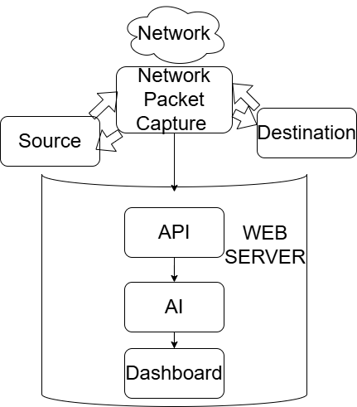
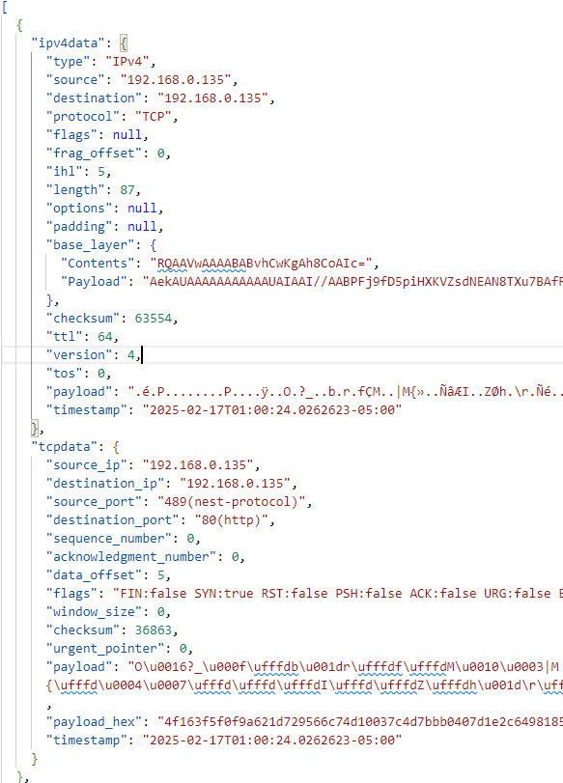
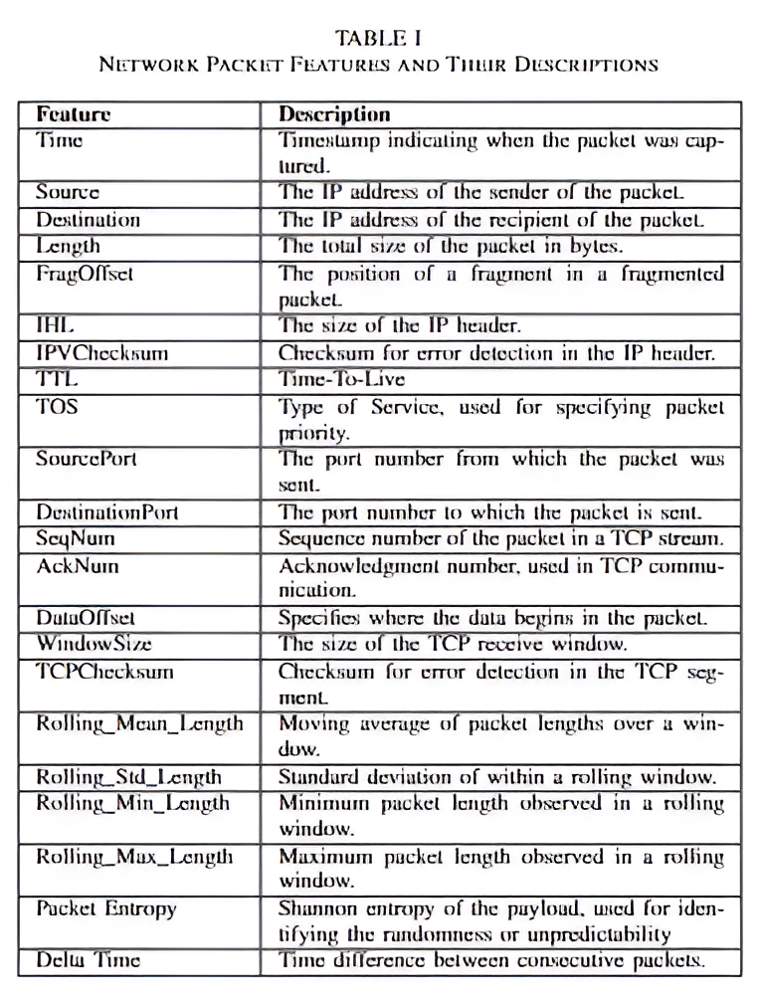
ANOMALYZE: Leveraging AI for Live Network Threat Detection & Visualization
Angel Bajracharya Giovanny Joseph
Background
Intro
Methods
Results
Dashboard
Conclusion
Network Packet Capture: Records all packet communication
Web Server: Contains All logic
API: Receives data from packet capture
AI: Analyzes data from AI
Dashboard: Displays all information of AI analysis
Scans network for IPv4 TCP packets, serializes results, and sends to 3 mediums:
API →sends to dashboard display
File → saves packet log as JSON file
Console → debugging output
Delta Time: time difference between consecutive packets.
Payload Entropy: Measures the randomness or unpredictability of packet content.
Rolling Statistics (min, max, mean, and standard deviation) for: Packet Length, Payload Length, TCP Payload Length
TECH STACK: GoLang (with gopacket), Python (with pandas, matplotlib, seaborn, scikit-learn), Django, HTML, CSS, JavaScript.

Slide 4
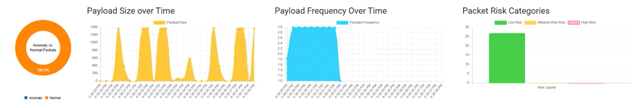
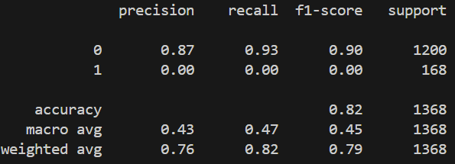
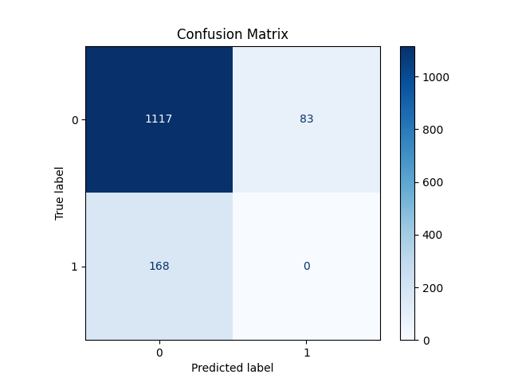
ANOMALYZE: Leveraging AI for Live Network Threat Detection & Visualization
Angel Bajracharya Giovanny Joseph
Background
Intro
Methods
Results
Dashboard
Conclusion
Model Testing Dataset
High accuracy on normal traffic: The model correctly identifies 93% of normal packets with a precision of 87%, showing strong performance in recognizing benign activity.
Lots of false negatives: The model fails to identify anomalous packets correctly (0% recall and precision for anomalies), indicating a major gap in its ability to flag suspicious activity.
Impact of class imbalance: The model is heavily biased toward the majority class (normal traffic), likely due to the imbalance in the dataset. Improving performance will require addressing this issue through resampling techniques or adjusting the model’s sensitivity.
System Performance (Tested Locally):
Specs: Ryzen 5 7600X3D, RTX 4070 Super, 32GB DDR5
Web Server Boot Time: 0.5s
Frontend Request Interval: 0.25s
AI Training Time: 1.45s
AI Response Time: 0.014s
Total Startup Time: 2.20s
Total Post-Startup Delay: ~0.02s
Intervals Tested:1s, 0.5s, 0.25s
Performance remained consistent across intervals

Slide 5
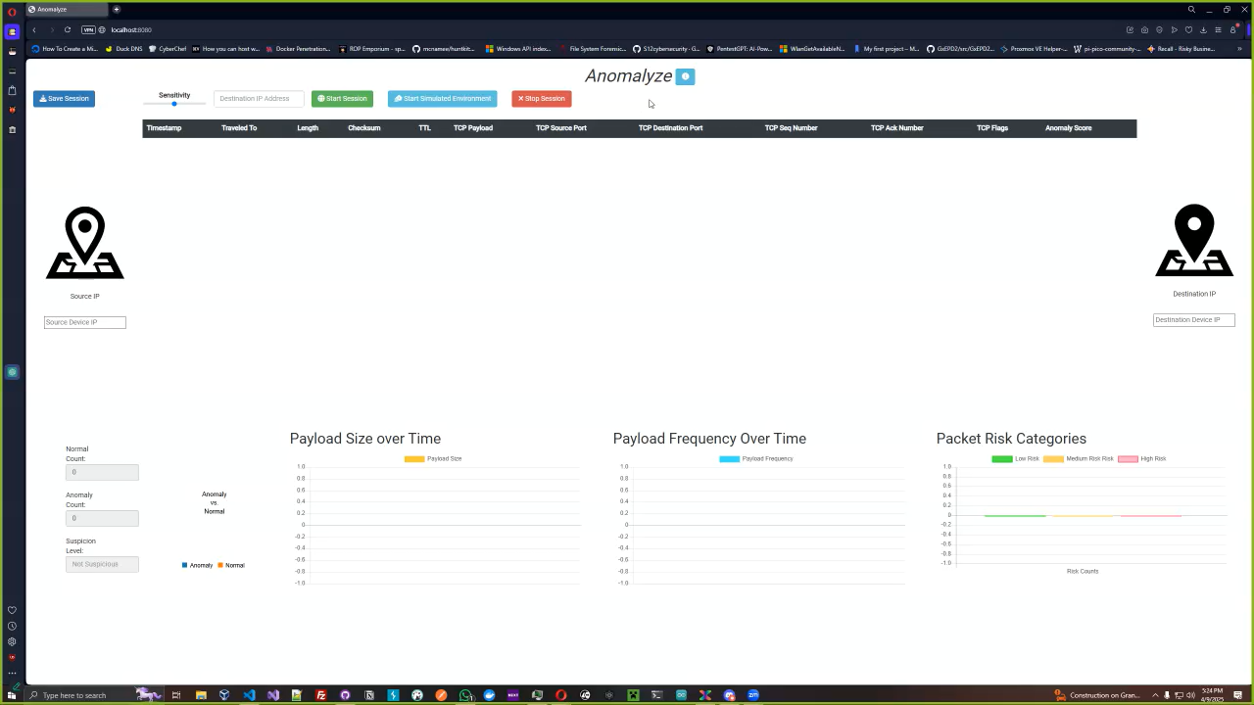
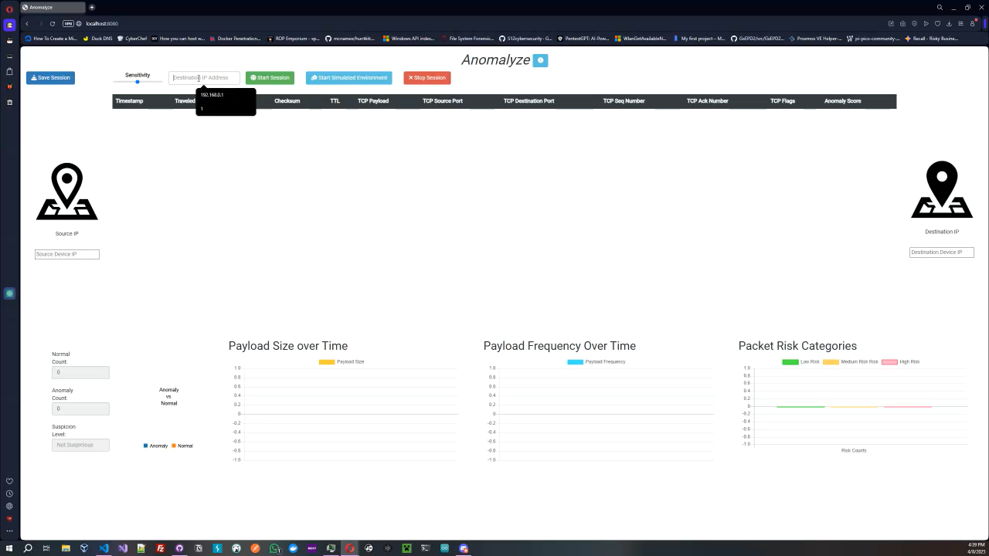
ANOMALYZE: Leveraging AI for Live Network Threat Detection & Visualization
Angel Bajracharya Giovanny Joseph
Background
Intro
Methods
Results
Dashboard
Conclusion
Simulated Environment
Sends packets of three categories
Buffer overflow: large payload size
SYN Flood: high volume of packets sent at once
Normal: packets that are like regular internet traffic
Used in testing and creation of datasets for AI
User-Specified Target IP
Examples of common IP addresses to test:
8.8.8.8 (Google)
1.1.1.1 (Cloudflare)
Allows monitoring of specific, real-world IP addresses
Provides insights into real-time traffic and potential risks in network traffic from known IPs
FEATURES:
Sensitivity Slider Simulated Environment Mode Live Environment Mode Stop Session Save Session

Slide 6
ANOMALYZE: Leveraging AI for Live Network Threat Detection & Visualization
Angel Bajracharya Giovanny Joseph
Background
Intro
Methods
Results
Dashboard
Conclusion
Conclusion
Acknowledging model limitations: While the current anomaly detection model does not successfully identify anomalous traffic, it performs well in recognizing normal patterns.
Strong dashboard foundation: Despite model shortcomings, the dashboard effectively visualizes packet-level data, time trends, and integrates real-time prediction logic for future use.
Future Areas of Improvement:
With a refactored feature engineering process and resampling strategies to address class imbalance, the model’s accuracy can be significantly improved—making the dashboard a highly effective network security tool.
Additional attack vectors may be incorporated to enhance detection robustness.
References
[1] U. Nations, “The Impact of Digital Technologies,” United Nations. Accessed: Feb. 09, 2025. [Online].
[2] “Executive Summary — NIST SP 1800-25 documentation,” National Cybersecurity Center of Excellence. Accessed: Feb. 09, 2025. [Online].
[3] “Packet analysis for network forensics: A comprehensive survey -ScienceDirect.” Accessed: Feb. 09, 2025. [Online].
[4] R. A. Kemmerer and G. Vigna, “Intrusion detection: a brief history and overview,” Computer, vol. 35, no. 4, pp. supl27–supl30, Apr. 2002.
[5] I. Corona, G. Giacinto, and F. Roli, “Adversarial attacks against intrusion detection systems: Taxonomy, solutions and open issues,” Inf. Sci., vol.239, pp. 201–225, Aug. 2013.
[6] L. Fritsch, A. Jaber, and A. Yazidi, “An Overview of Artificial Intelligence Used in Malware,” in Nordic Artificial Intelligence Research and Development, E. Zouganeli, A. Yazidi, G. Mello, and P. Lind, Eds., Cham: Springer International Publishing, 2022, pp. 41–51.
[7] K. Megas, “Managing Cybersecurity and Privacy Risks in the Age of Artificial Intelligence: Launching a New Program at NIST,” NIST, Sep. 2024, Accessed: Feb. 09, 2025. [Online].

